Slide 1



University of Layyah
Dept. of Information Technology
QUALITY ENGINEERING & SYSTEM VALIDATION
Comprehensive SQA Audit of the Toolshop Platform
Khadija Zafar
QA Lead
Areej Fatima
Automation Engineer
Saba Shahzad
API Specialist
Hannia Fatima
Test Manager

Slide 2
SUBJECT: SOFTWARE TESTING & QUALITY ASSURANCE
Website: https://practicesoftwaretesting.com/
Class
BSIT Morning (A)
Semester
5th
Session
2023-27
Course & Lab Instructor
Mr. Faisal Hafeez

Slide 3

EXECUTIVE SUMMARY
Overview of Engagement
This engagement established a rigorous validation framework for the Toolshop Ecommerce platform, focusing on functional integrity, accessibility, and backend stability.
43 Total Test Cases executed across all tiers.
93.02% Success Rate across the system.
100% Stability in API and Automation layers.

Slide 4





DIGITAL INFRASTRUCTURE
Automation
API Suite
Governance
Playwright/Python test_toolshop.py modular script utilizing networkidle states for stability.
Postman Collection 8 validated endpoints with automated assertions and JWT security audits.
Jira Cloud (TQP) Real time lifecycle management for all identified defects and vulnerabilities.

Slide 5


REQUIREMENT DESCRIPTION
User Lifecycle
Discovery
Interactivity
Validating guest-to-member journey, registration integrity, and alert-danger protocols.
Ensuring keyword search precision and dynamic filtering (Price Slider) accuracy.
Mandatory Hover State Compliance for all primary navigation and action buttons.

Slide 6

VISUAL INTERACTIVITY
A critical project requirement was the verification of UI/UX like Hover Effects on primary action buttons (Sign In, Login, Sign Up).
Testing ensured that cursor targeting triggers immediate CSS state changes, providing essential feedback for web accessibility and user engagement.

Slide 7





TESTING METHODOLOGY
Manual
Automation
API/Backend
Focus on logical nuances, exploratory testing, and visual feedback mechanisms.
Safeguarding "Happy Path" journeys via Playwright regression safety nets.
Validating the "headless" architecture directly via Postman assertions.

Slide 8

MANUAL EXECUTION RESULTS
Category | Description | Status | Linked Bug
Authentication | Valid/Invalid credentials validation | PASS | None
Registration | Verify success message visibility | FAIL | TQP-2
Filtering | Price Slider logic ($0 to $200) | FAIL | TQP-1
UI Design | Hover Effects on primary buttons | PASS | None

Slide 9

AUTOMATED TESTING LOGIC
Checkpoints Sequence
Environment Sync: SSL Handshake & URL verification.
Hover Validation: Sign-In and Home link states.
Security: Negative Login check (.alert-danger).
Persistence: /account dashboard redirection.
Functional: Search "Hammer" result grid loading.
State: Cart badge counter increment (0 to 1).

Slide 10

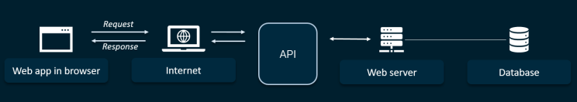
POSTMAN API VALIDATION
08
100%
ENDPOINTS AUDITED
ASSERTION PASS RATE
Tested JWT generation, product sorting, and hierarchical JSON structures for maximum backend integrity.

Slide 11
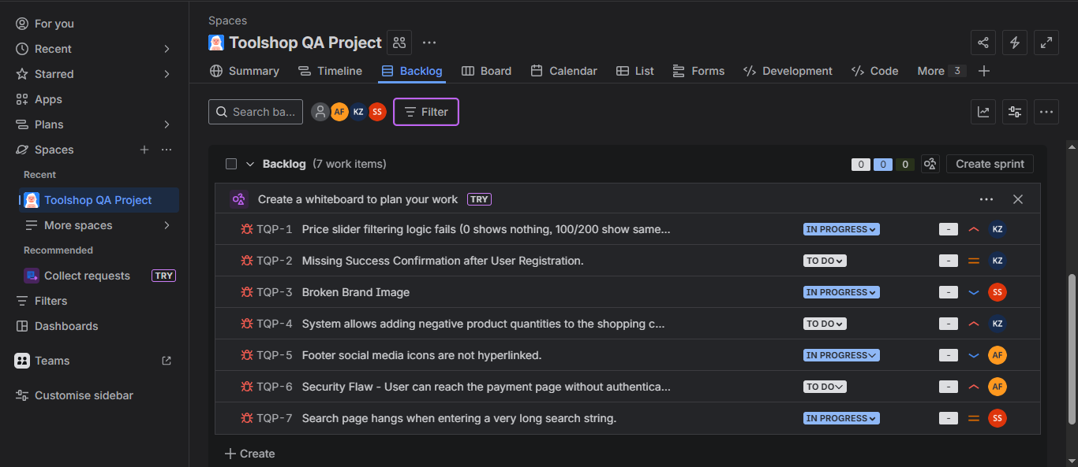
DEFECT MANAGEMENT
Governance Framework
Every anomaly documented as a "Ticket" within the
TQP Backlog on Jira Software Cloud.
Priority: Business urgency levels.
Attachments: Screenshots of the problems.
Audit Trail: Full reproducibility steps.

Slide 12
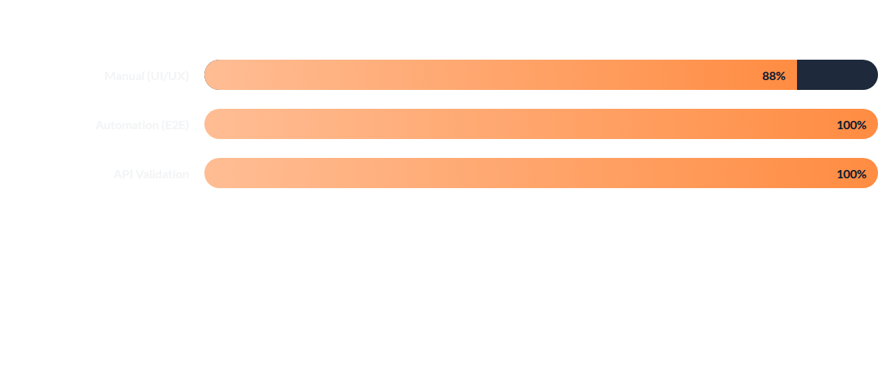
PERFORMANCE METRICS
93.02%
OVERALL SUCCESS

Slide 13
REQUIREMENT TRACEABILITY
Req. ID | Requirement Description | Manual Test Case ID | Automation ID | API Request ID | Status | Linked Defect
REQ-01 | User Authentication | TC-01, 02, 03, 04, 05 | TC-AUTO-05, 06 | TO-API-07 | PASS | None
REQ-02 | Product Discovery | TC-06, 07 | TC-AUTO-07, 08 | TO-API-02 | PASS | None
REQ-03 | Interactive UI | TC-05 | TC-AUTO-02, 03 | N/A | PASS | None
REQ-04 | Registration Flow | N/A | N/A | N/A | FAIL | TQP-2
REQ-05 | Product Filtering | TC-10 | N/A | N/A | FAIL | TQP-1
REQ-06 | Cart Management | TC-12, 13, 14, 15 | TC-AUTO-09, 10 | N/A | PASS | None
REQ-07 | Backend Integrity | N/A | N/A | TO-API-03, 04, 08 | PASS | None
REQ-08 | Security & Logic | N/A | N/A | N/A | FAIL | TQP-4, TQP-6

Slide 14


ENGAGEMENT LIFECYCLE
Phase 1
Phase 2
Phase 3
Phase 4
SRD Definition & Risk Assessment
Manual & Exploratory Execution
E2E Automation & API Audits
Final Quality Assessment

Slide 15

Strategic Observations
The Toolshop Platform demonstrates strong backend stability (100% API Pass) and effective UI feedback compliance.
Critical functional failures in Price Filtering and Registration Feedback require urgent technical remediation to prevent revenue loss and user churn.

Slide 16

QUESTIONS?
Thank you for your attention.
Prepared by The QA Project Team
Khadija Zafar | Areej Fatima | Saba Shahzad | Hannia Fatima
BSIT Morning A (2023-27)

